Slide 1


Unit 3: Lesson 11 Bitten by the travel bug

Slide 2
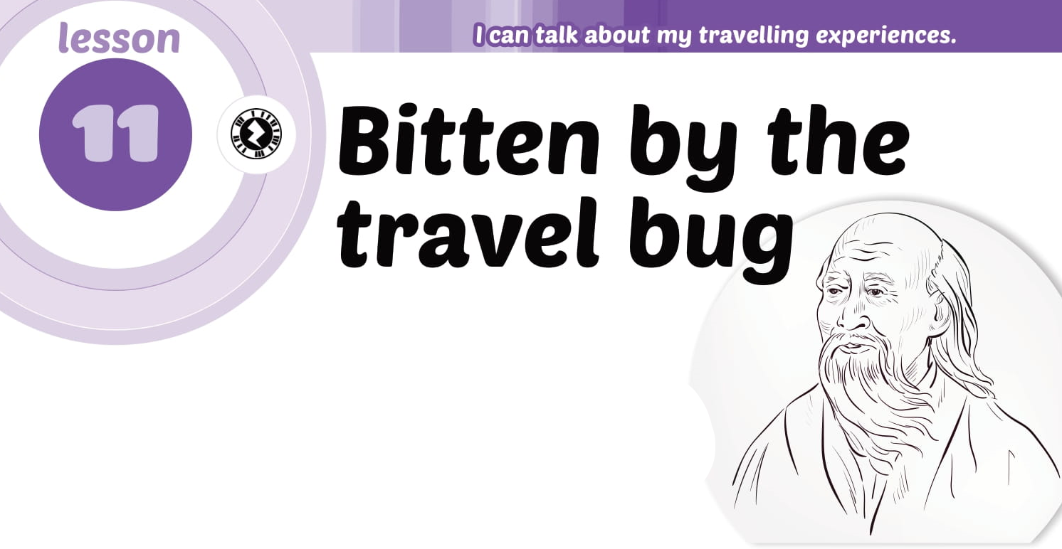
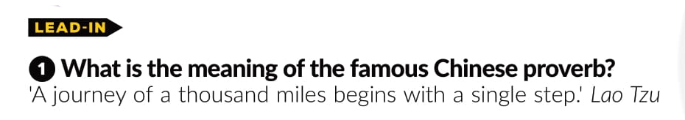

Slide 3
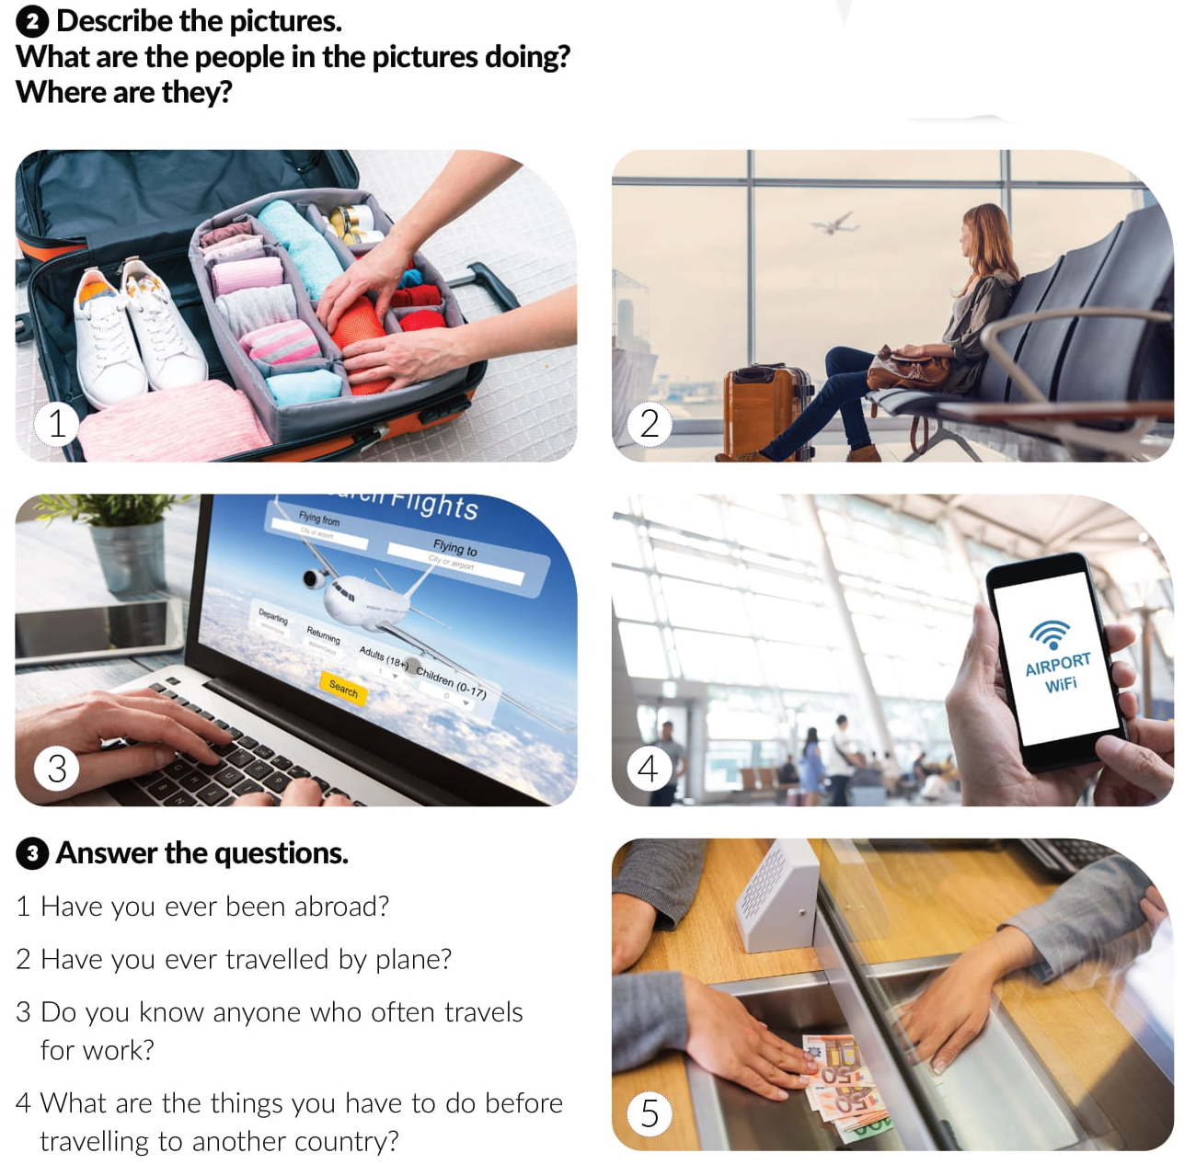

Slide 4

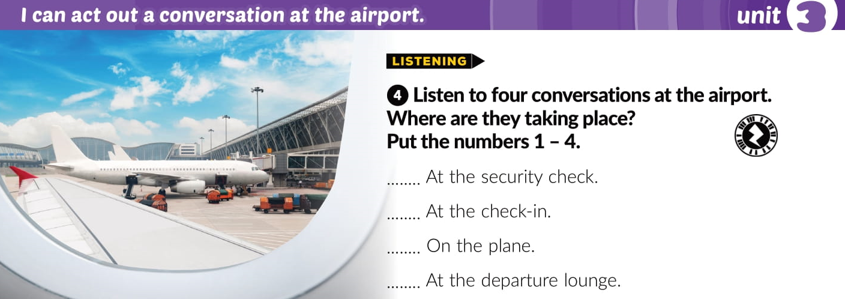
1
2
3
4
2
1
4
3

Slide 5
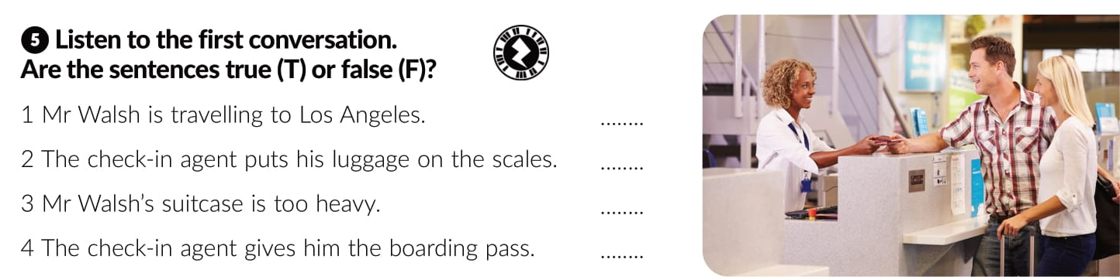
F
T
T
T

Slide 6
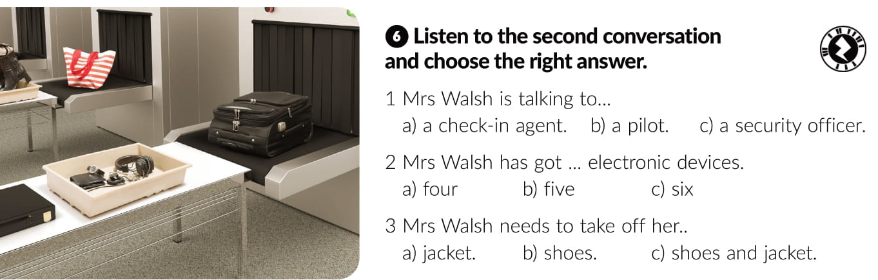

Slide 7
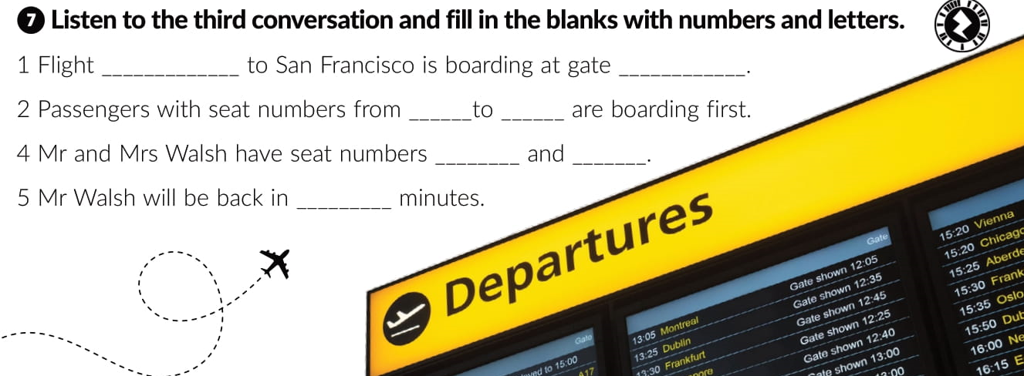
AA 255
68
12
32
10A
10D
5

Slide 8
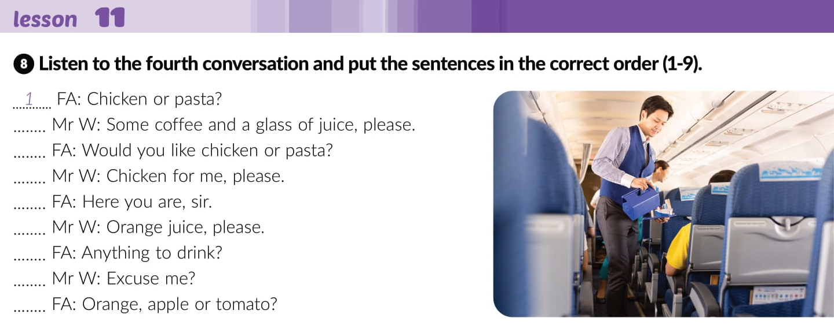
6
3
4
9
8
5
2
7

Slide 9
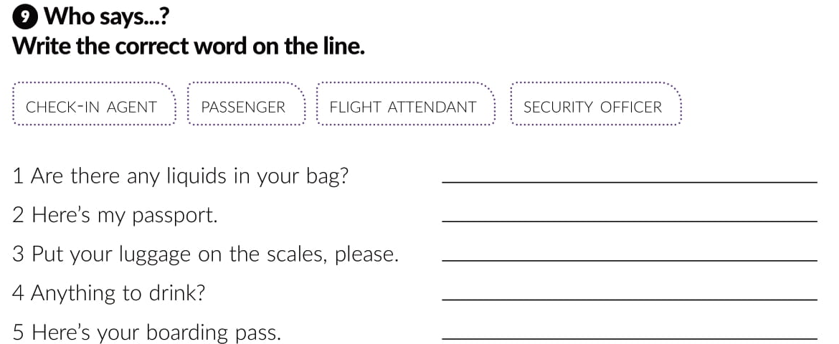
SECURITY OFFICER
PASSENGER
CHECK-IN AGENT
FLIGHT ATTENDANT
CHECK-IN AGENT

Slide 10
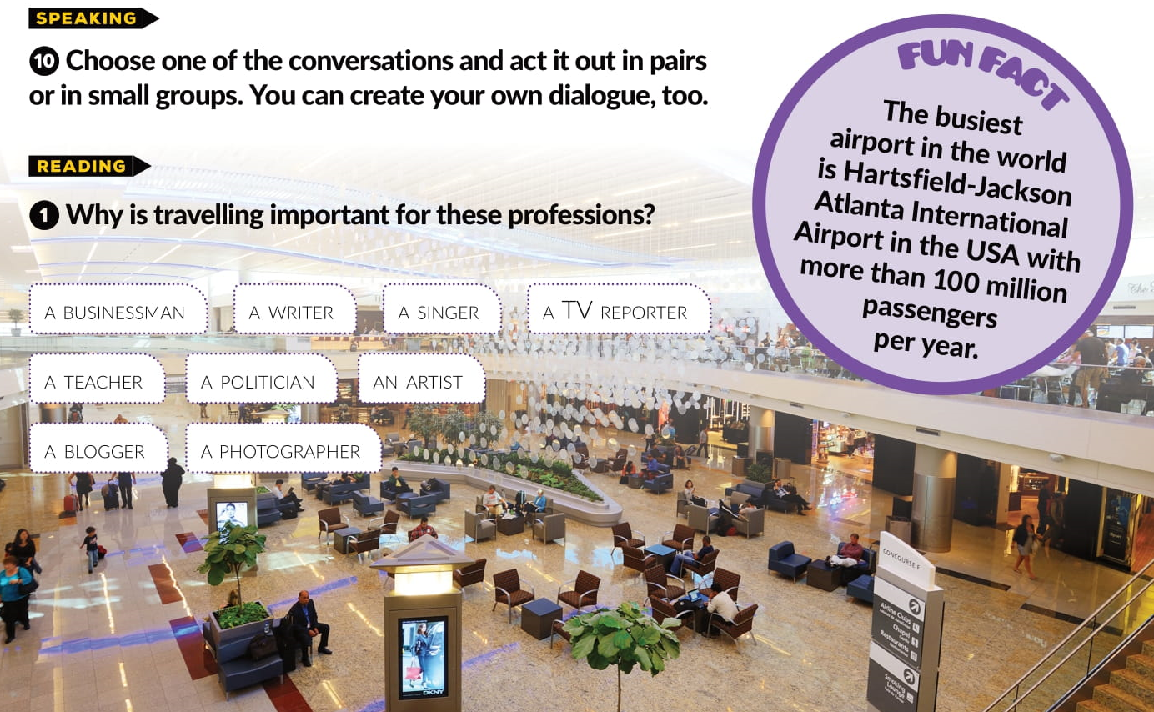

Slide 11
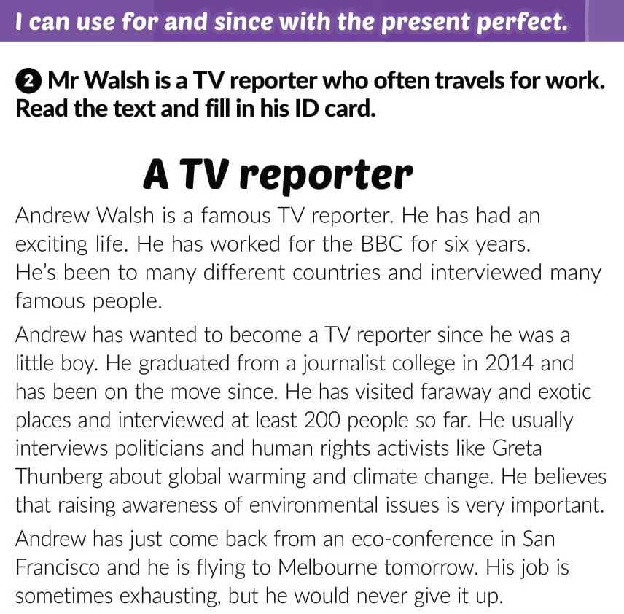
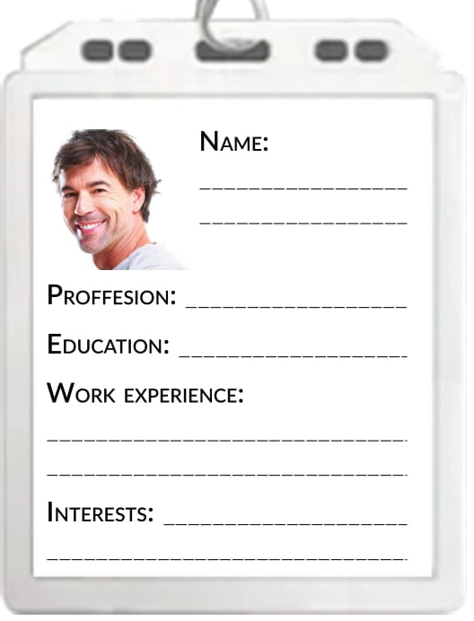
Andrew Walsh
TV reporter
journalist college
BBC for 6 years; interviews politicians and activists
Environmental issues

Slide 12
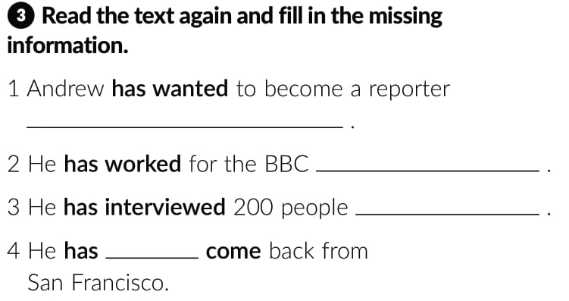
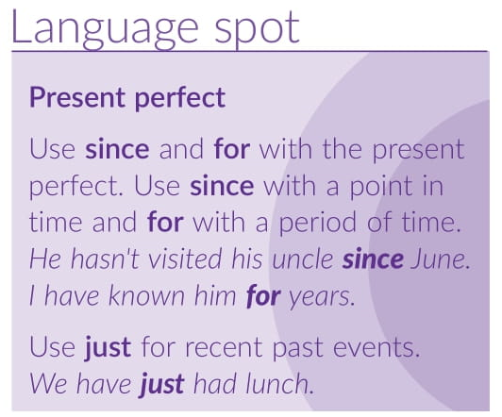
since he was a little boy
for six years
so far.
just

Slide 13
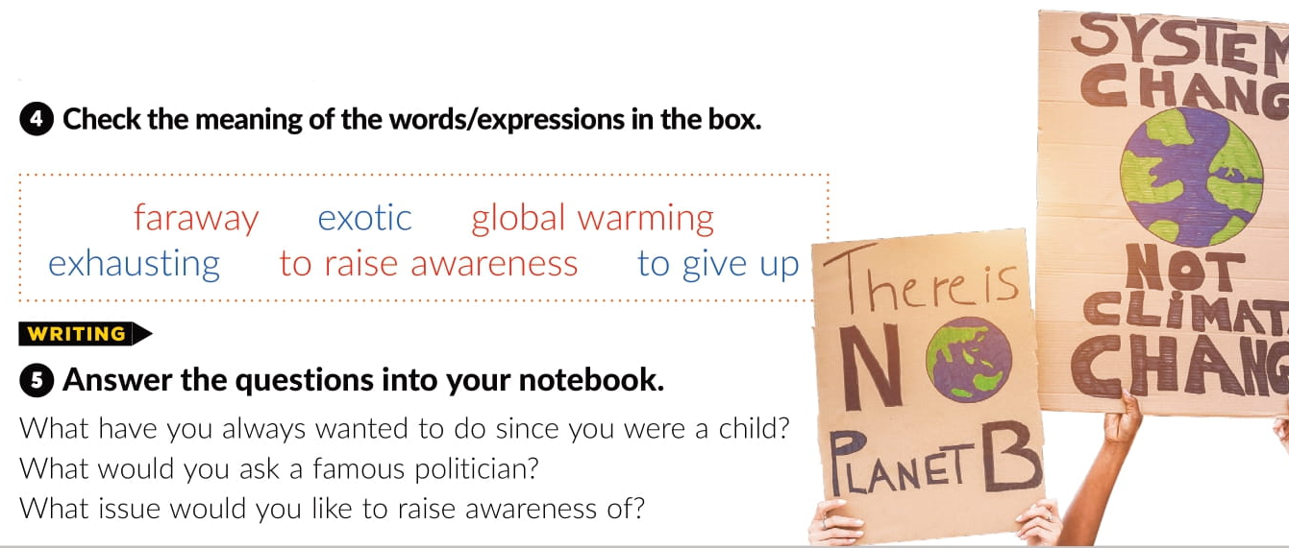
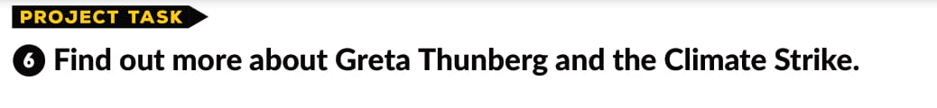

Slide 14

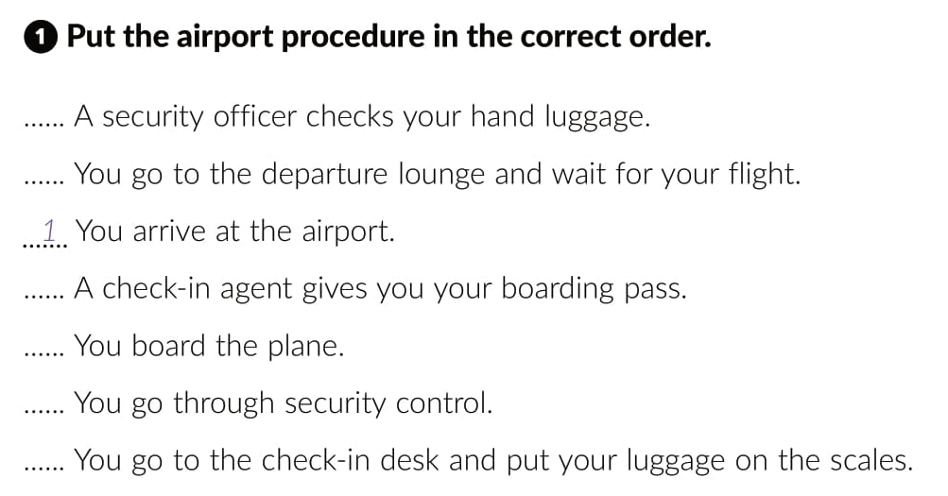
workbook p. 45
4
6
3
7
5
2

Slide 15
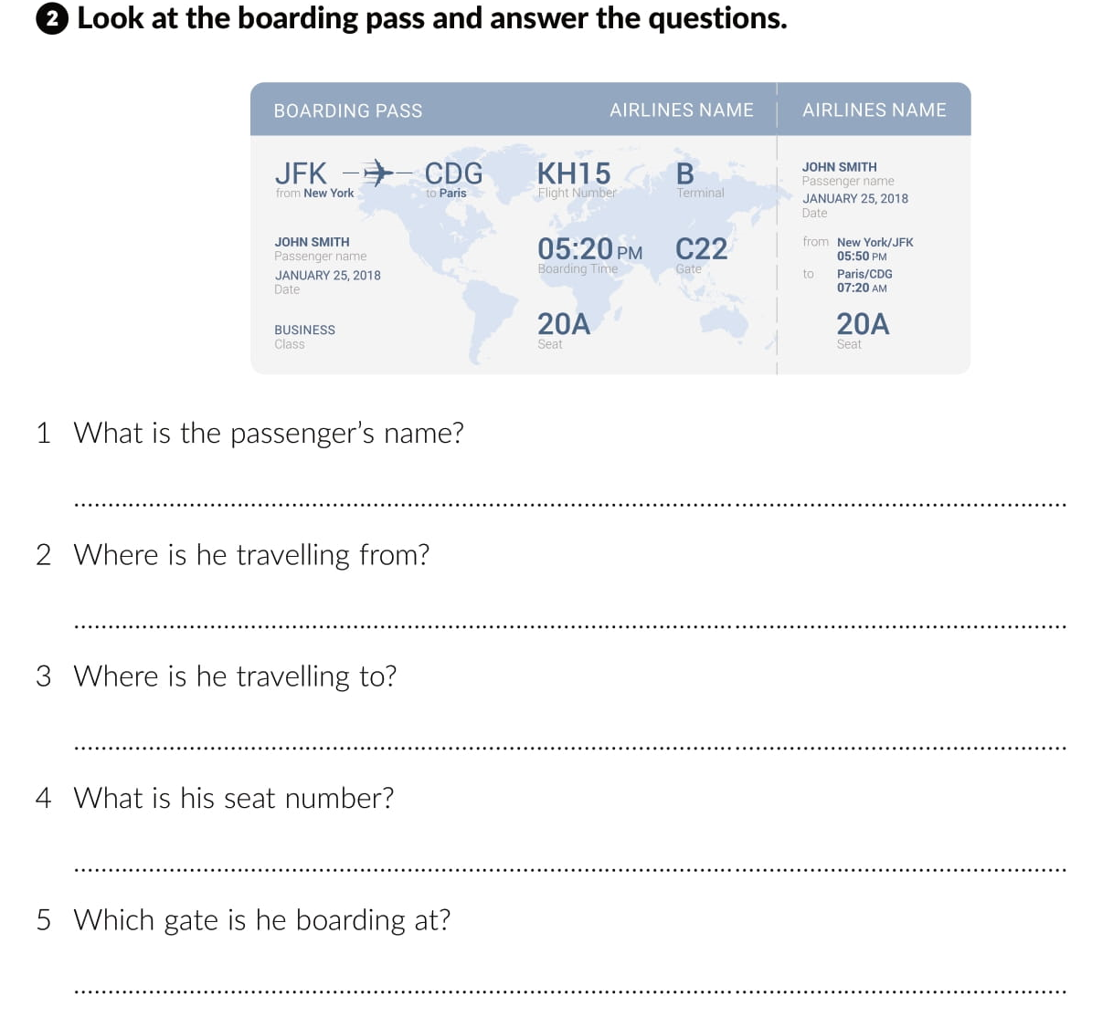
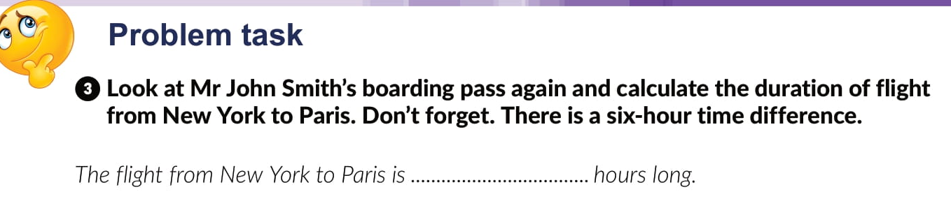
John Smith
New York
Paris
20A
C22
7.5

Slide 16
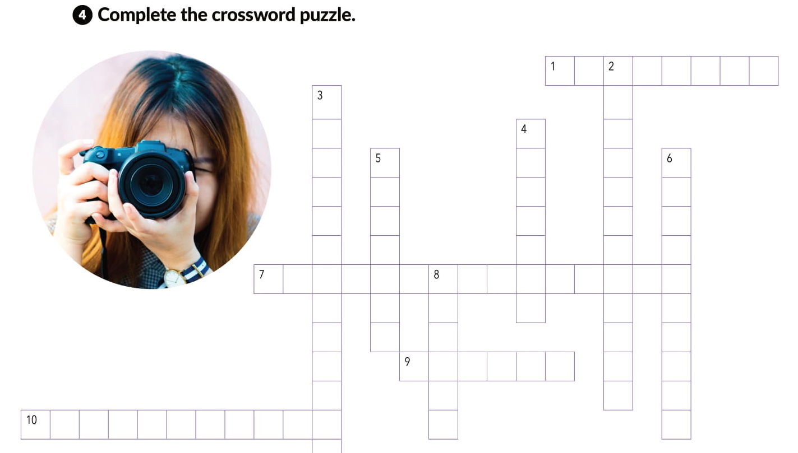
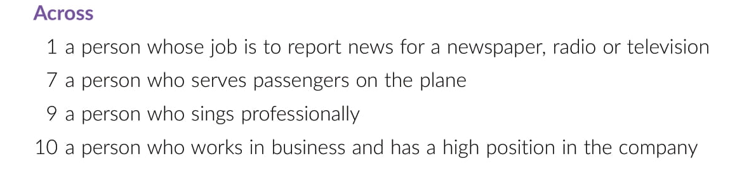
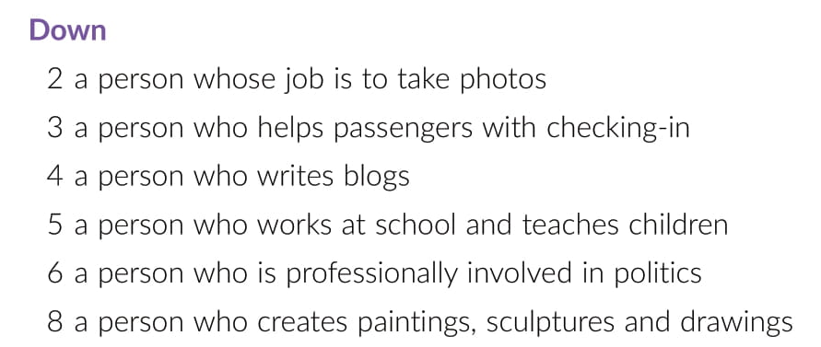
R E P O R T E R
C
H
E
CK
-
I
N
A
G
E
N
T
H O T O
G
R
A
P
H
E
R
B
L
O
G
G
E
R
T
E
A
C
H
E
R
P
O
L
I
I
C
I
A
N
F L G T A T T N D N T
R
T
I
S
T
S N G E R
B U S I N E S S M A

Slide 17
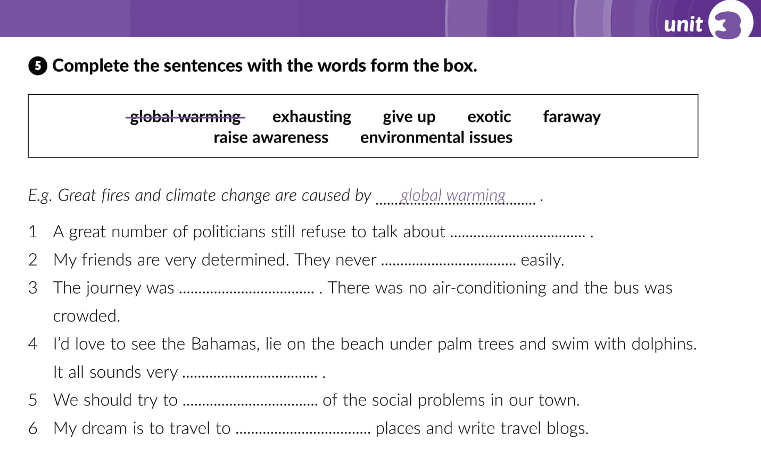
environmental issues
give up
exhausting
exotic
raise awareness
faraway

Slide 18
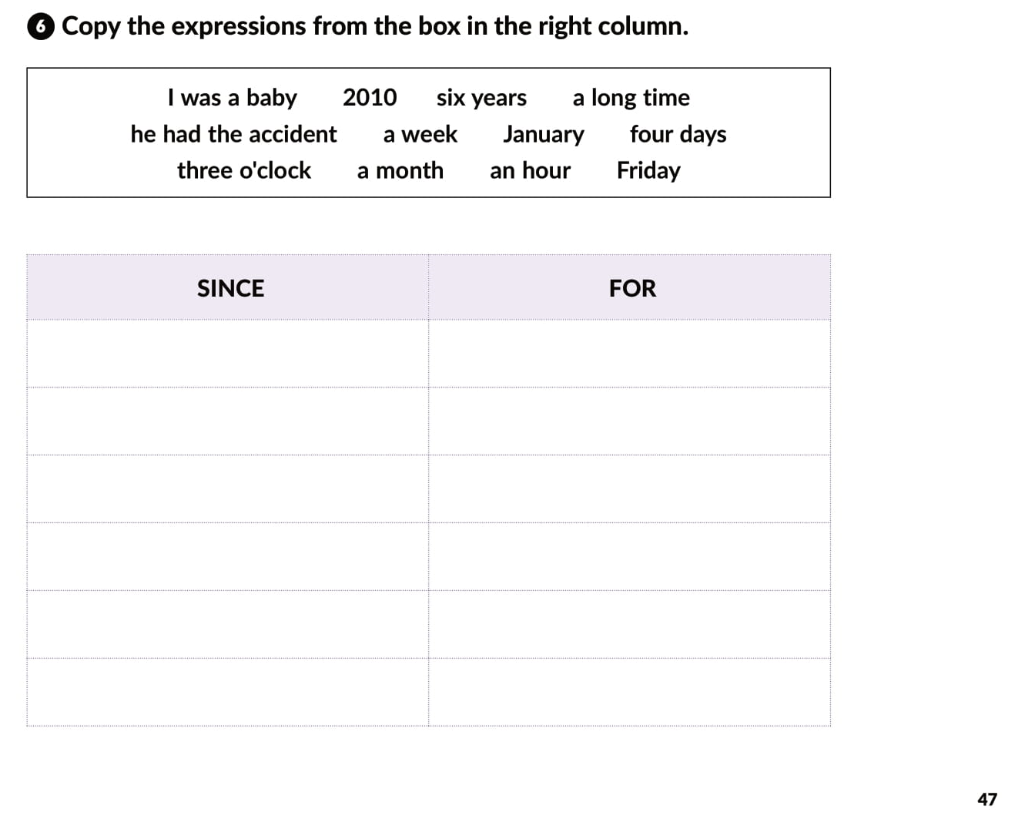
I was a baby
six years
2010
a long tine
he had the accident
a week
January
four days
three o’clock
a month
Friday
an hour

Slide 19
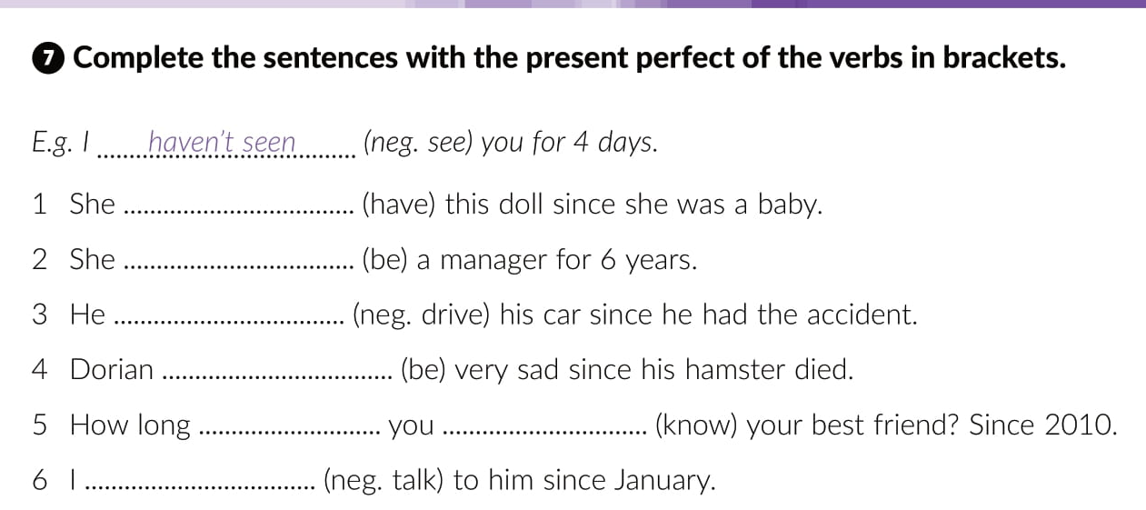
has had
has been
has not driven
has been
have
known
have not talked

Slide 20
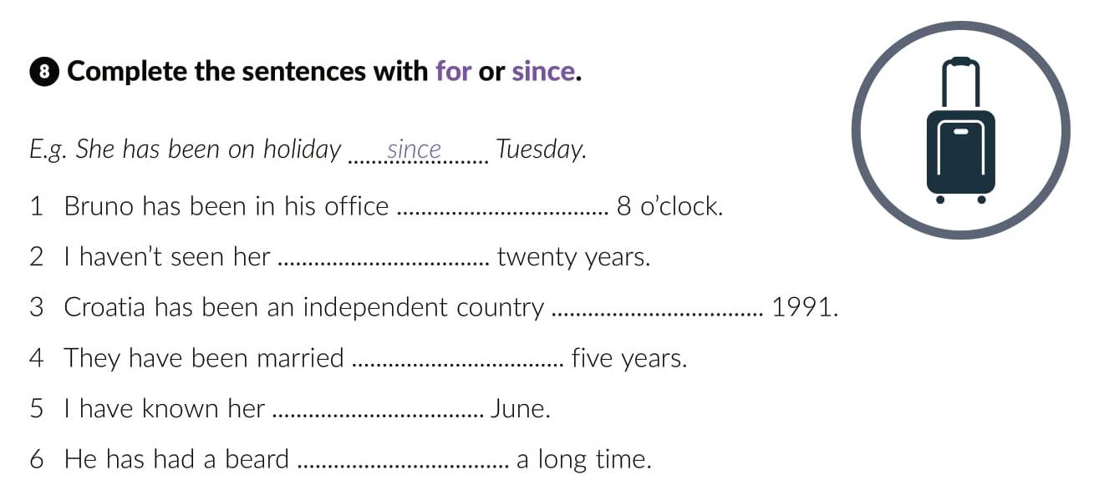
since
for
since
for
since
for

Slide 21
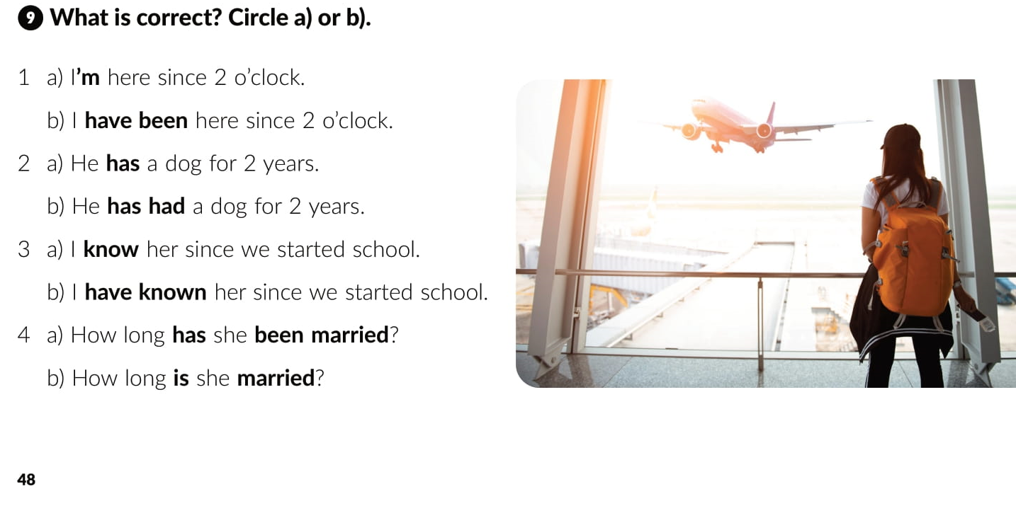

Slide 22
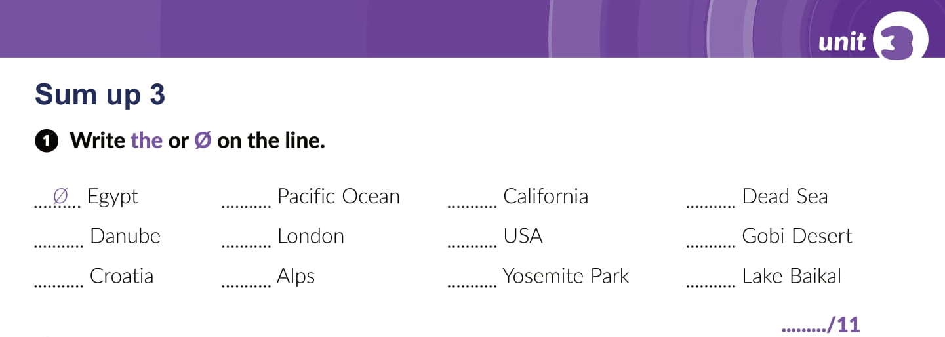
the
Ø
the
the
Ø
the
the
Ø
the
Ø
Ø

Slide 23
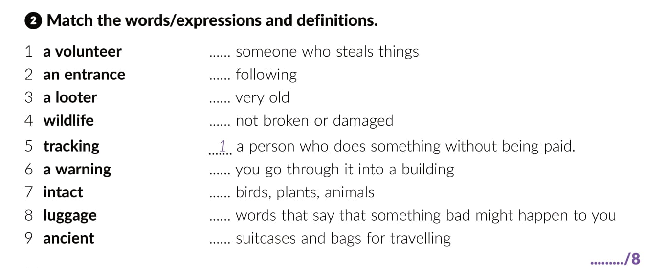
3
5
9
7
2
4
6
8

Slide 24
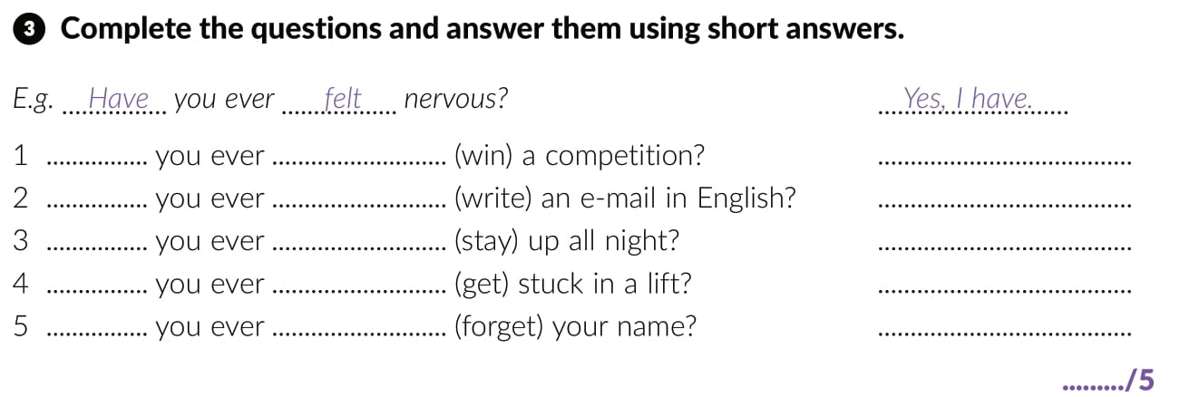
Have
won
Have
written
Have
stayed
Have
got
Have
forgotten

Slide 25
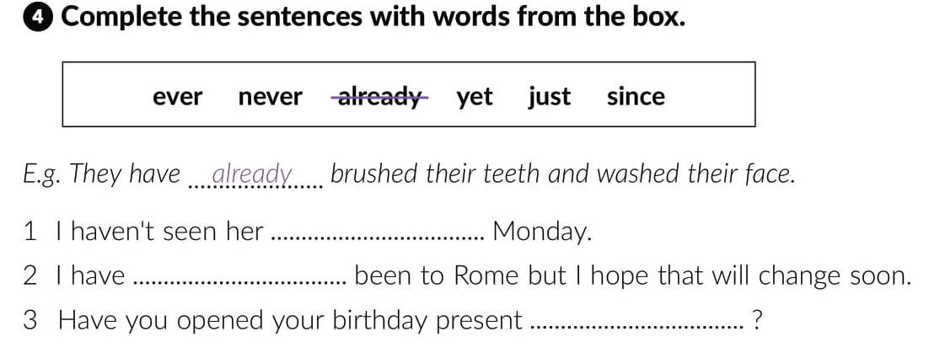
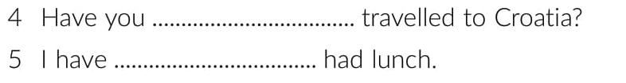

since
never
yet
ever
just

Slide 26
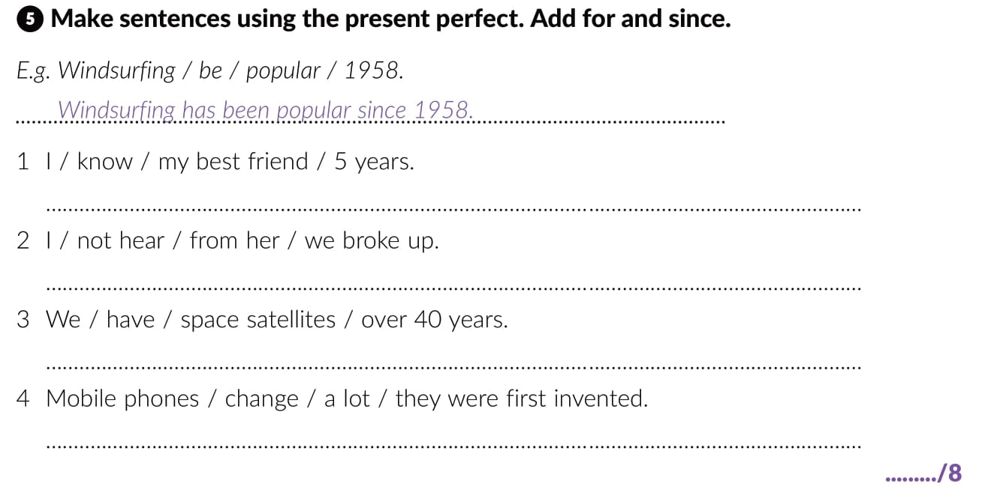
I have known my best friend for 5 years.
I have not heard from her since we broke up.
We have had space satellites for over 40 years.
Mobile phones have changed a lot since they were first invented.

Slide 27
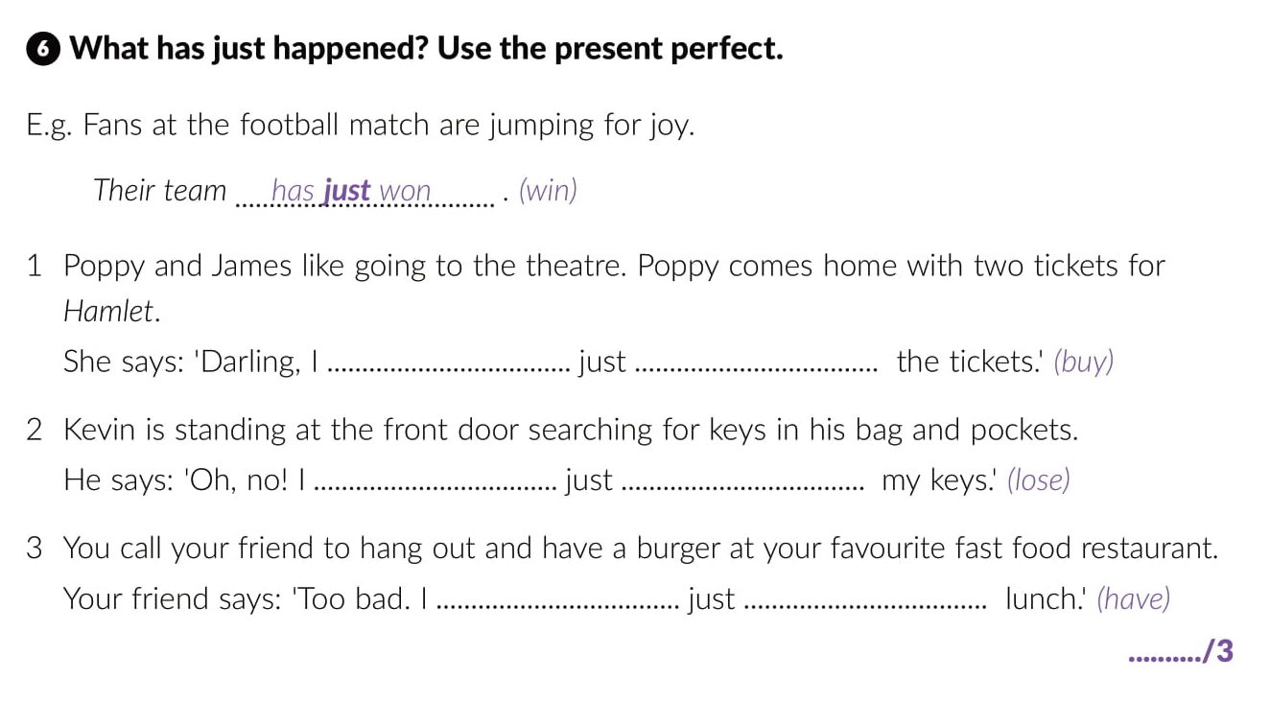
have
bought
have
lost
have
had

Slide 28
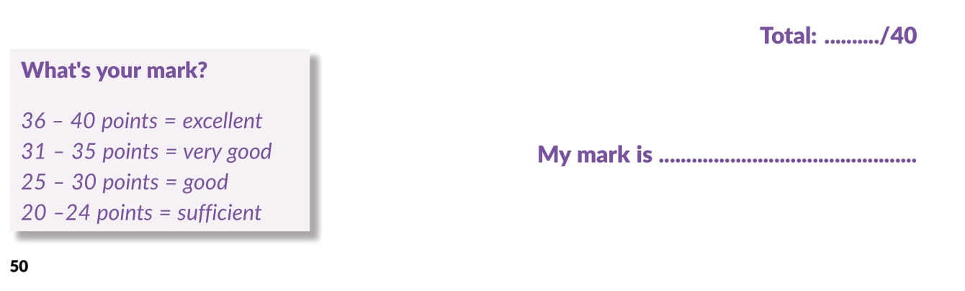

Slide 29
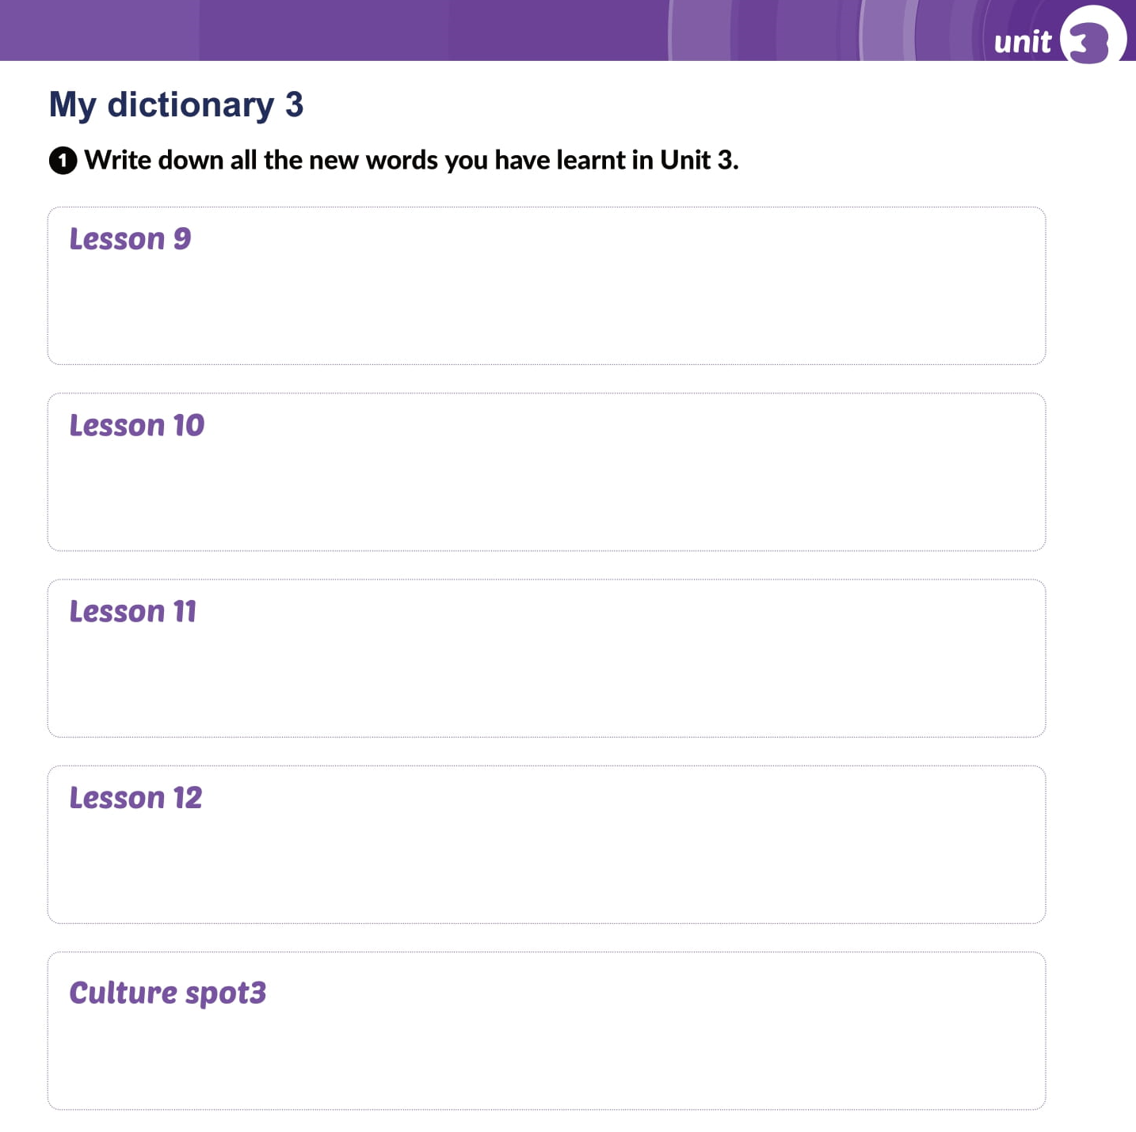
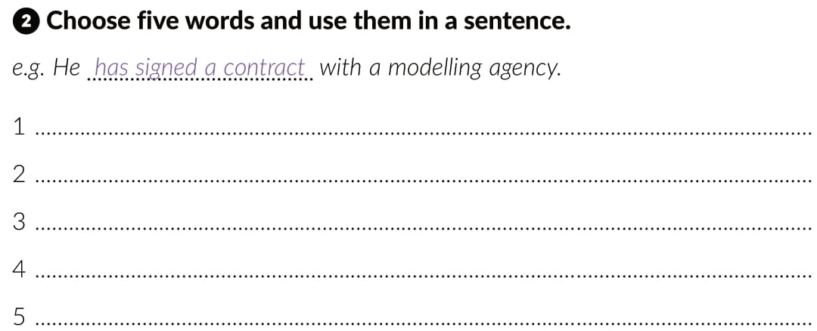

Slide 30

PLAY AND LEARN
Lesson 11 Bitten by the travel bug | Way to go 4 (e-sfera.hr)

